Slide 1
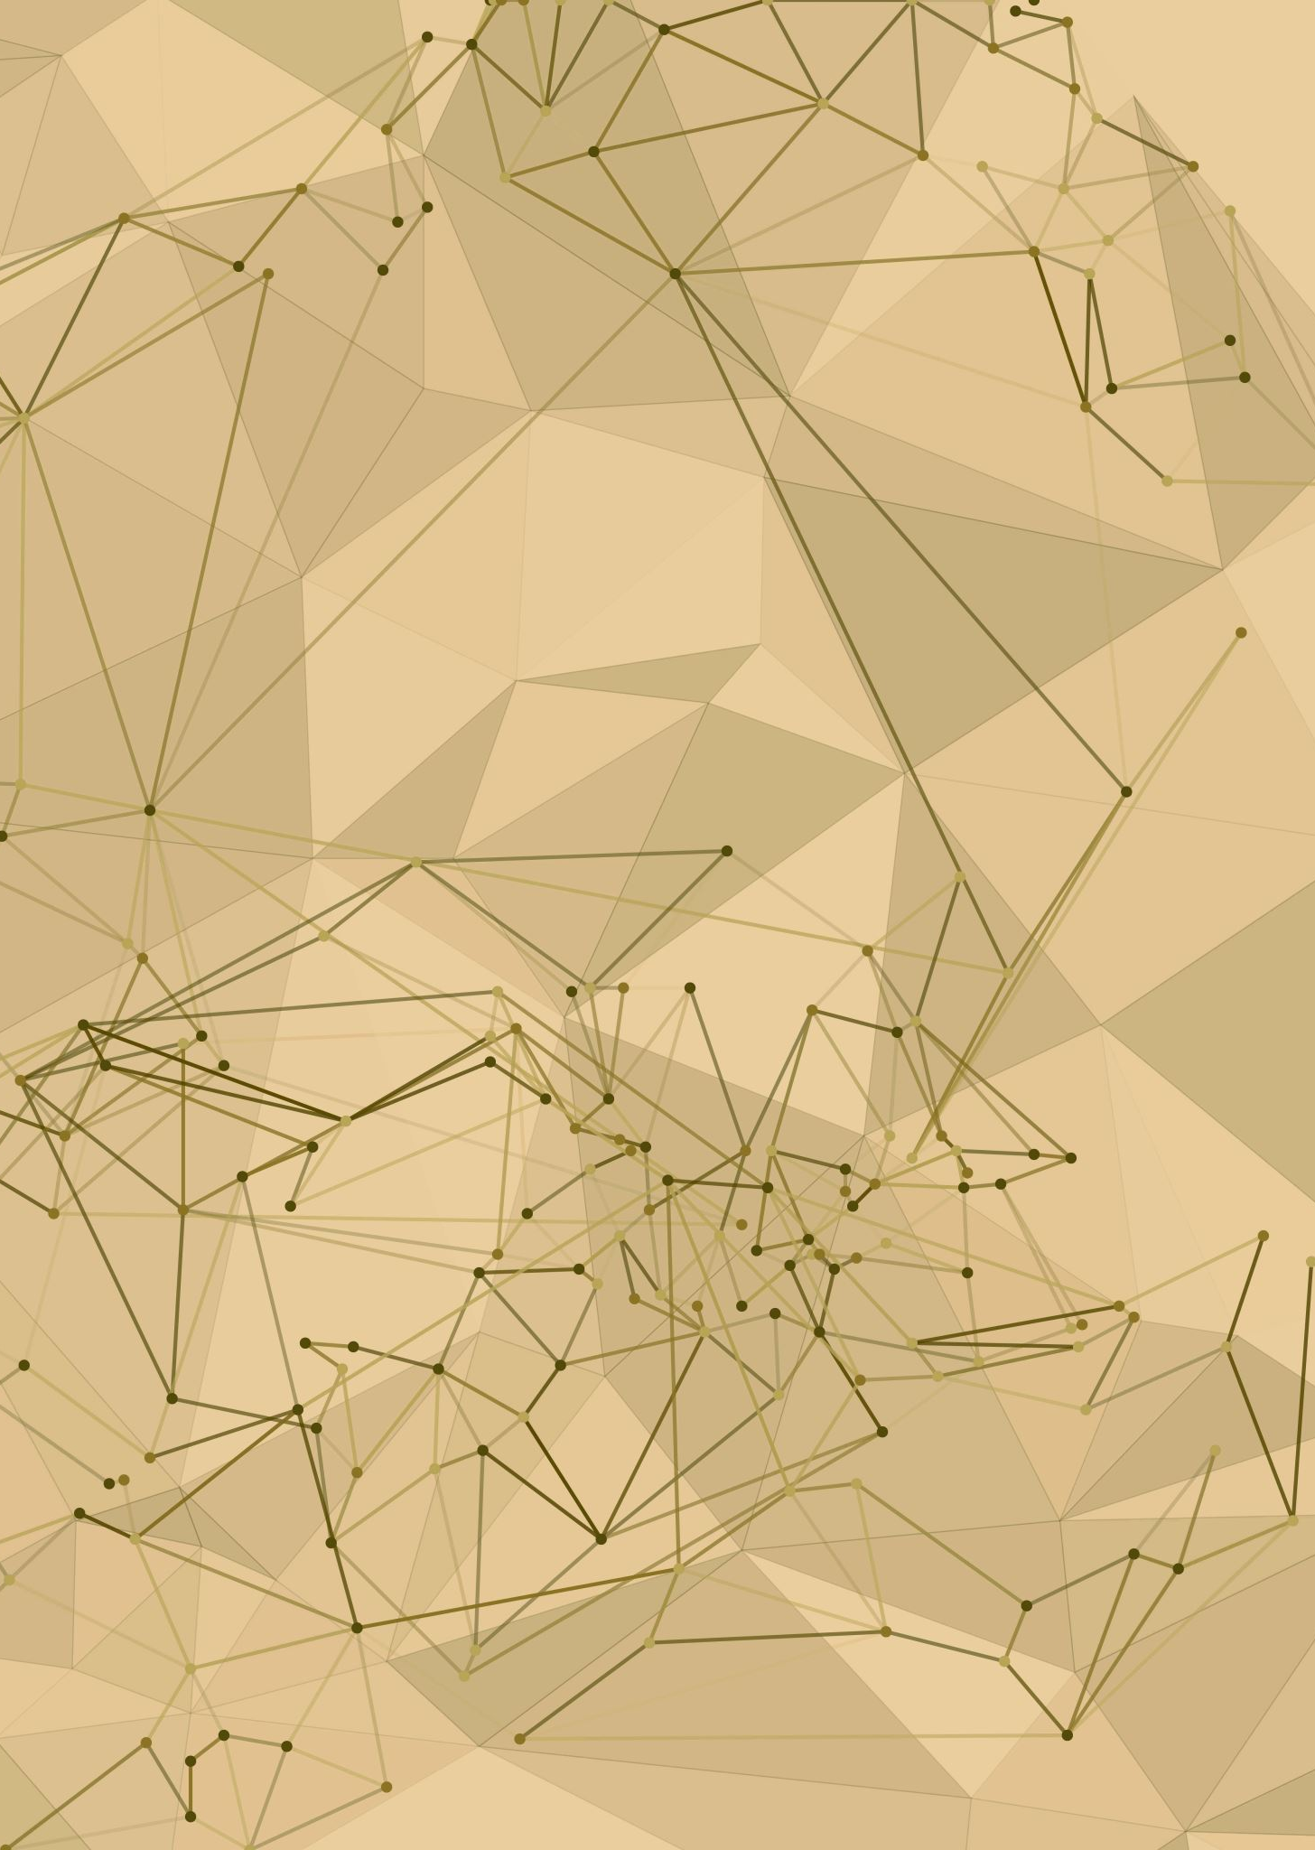
Community Detection using NetworkX
Sharath Kumar Karnati
011852253

Slide 2
Outline:
Introduction
Objective
Dataset used
Results
Future Scope
References

Slide 3
Introduction:
NetworkX is a Python language software package for the creation, manipulation, and study of the structure, dynamics, and function of complex networks. It is used to study large complex networks represented in form of graphs with nodes and edges. Using networkx we can load and store complex networks. We can generate many types of random and classic networks, analyze network structure, build network models, design new network algorithms and draw networks

Slide 4
Objectives:
In this project, I aim to leverage the capabilities of NetworkX to delve into its functionality, contrasting it with our current tool, igraph. Utilizing Python's widespread familiarity, I intend to highlight NetworkX's efficiency compared to igraph. Throughout my analysis, I've extensively explored and analyzed various graph parameters typically encountered in class assignments using NetworkX. Additionally, I've delved into community detection utilizing this library. In my report, I'll succinctly articulate the disparities between NetworkX and igraph, emphasizing NetworkX's strengths and its potential as a superior option.

Slide 5
Community Detection :
The concept of community detection has emerged in network science as a method for finding groups within complex systems through represented on a graph. In contrast to more traditional decomposition models which seek a strict block diagonal or block triangular structure, community detection methods find subnetworks with statistically significantly more links between nodes in the same group than nodes in different groups.

Slide 6
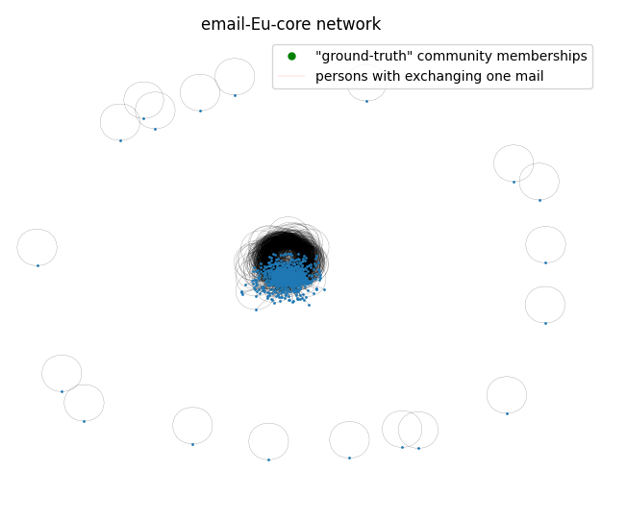
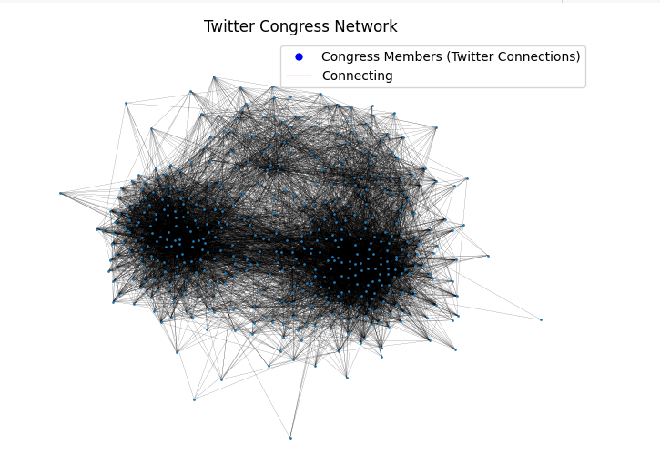
Dataset Information:
https://snap.stanford.edu/data/email-Eu-core.html
https://snap.stanford.edu/data/congress-twitter.html

Slide 7
Dataset statistics
E MAIL DATASET:
TWITTER DATASET:
Nodes : 1005
Edges : 25571
Nodes in largest WCC: 986 (0.981)
Edges in largest WCC: 25552 (0.999)
Nodes in largest SCC: 803 (0.799)
Edges in largest SCC: 24729 (0.967)
Average clustering coefficient: 0.3994
Number of triangles: 105461
Fraction of closed triangles: 0.1085
Directed: Yes.
Node features: No.
Edge features: Yes.
Nodes: 475
Edges : 13,289

Slide 8
Analysis of DataSet Using following parameters:
Community Detection
Centrality Measures
Shortest Path Algorithm

Slide 9
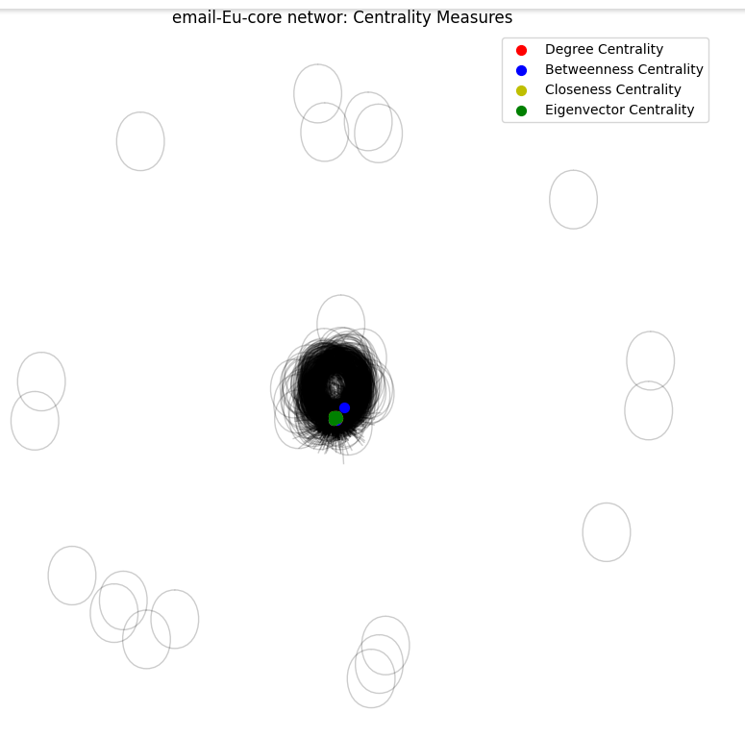
Centrality measures:

Slide 10
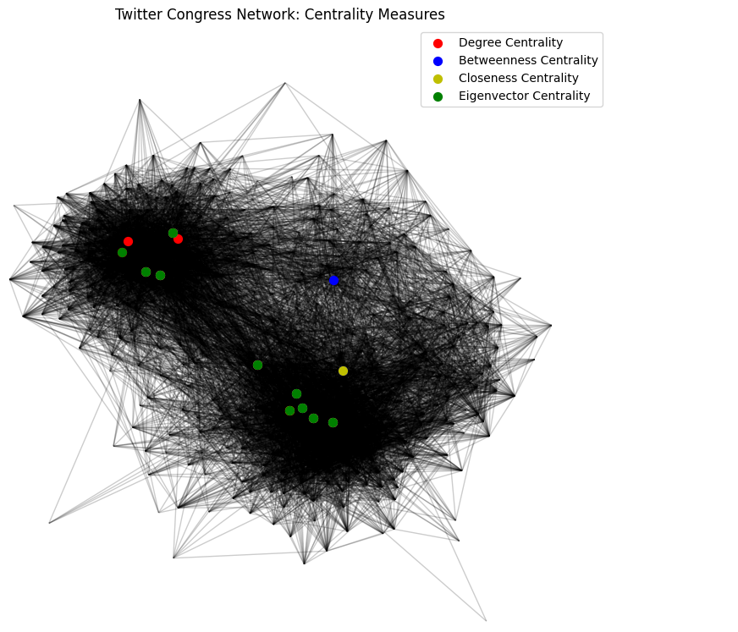
Centrality measures:

Slide 11
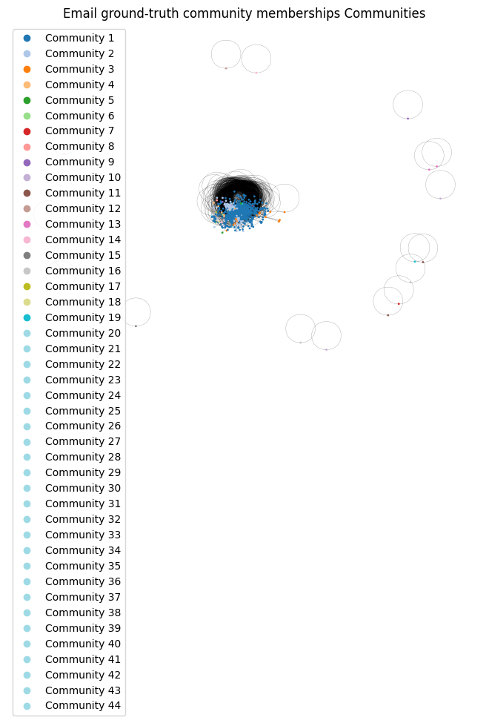
Community detection:

Slide 12
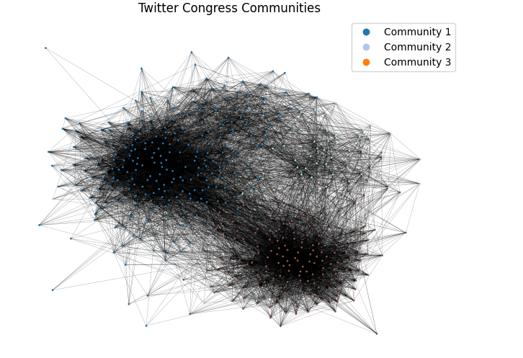
Community Detection:

Slide 13
Shortest Path Algorithm:
The average shortest path calculated for Email-core Network is
Dijkstra Algorithm: 2.5842596545002907
Random Walk Algorithm: 2.586933824816466
PageRank Algorithm: 2.408972312888047

Slide 14
Shortest Path Algorithm:
The average shortest path calculated for Congress Twitter Network is
Dijkstra Algorithm: 0.004423766546138872
Random Walk Algorithm: 0.004433099386953511
PageRank Algorithm: 1.9809904508105707

Slide 15

Tasks pending:
Will try to perform on a large dataset as it is talking so much time and space.
Need to do comparison analysis between NetworkX and igraph.
Need to document the work done till now and should make a final report
I failed to do the community detection using Leiden and Girvan-Newman Algorithms, will again try to do with them and compare each other.

Slide 16

Future Scope
There is a scope to design a time efficient Algorithm to perform the shortest path calculation for very large dataset.
We can extend these study into medical use cases such as detecting the virus spread zones etc.

Slide 17
References:
Community structure in social and biological networks by M. Girvan and M.E.J.Newman.
Exploring Network Structure, Dynamics, and Function using NetworkX Aric A. Hagberg,Daniel A. Schult,Pieter J. Swart.
SOCIAL NETWORK ANALYSIS USING PYTHON AND NETWORKX shivam shah, Sumitra Menaria.
Newman, M.E.J. (2010). Networks: An Introduction. Oxford University Press.
Community Evolution in Social Networks:Leskovec, J., Backstrom, L., Kumar, R., & Mahoney, M. W. (2009). What is the evolution of online social networks? In Proceedings of the 17th ACM SIGKDD international conference on knowledge discovery and data mining
Community structure in networks: Girvan-Newman algorithm improvement by Ljiljana Despalatović; Tanja Vojkovic; Damir Vukic̆evic.

Slide 18

Thank You

